Slide 1
$ my-portfolio
Yearnsmith/~
Or,
How I learned to stop worrying and
Love the Scss.█

Slide 2
$ brief -Brief
Yearnsmith/~
Build a portfolio in roughly 3 weeks
Level up skills
Audience: potential employer

Slide 3
$ challenge
Yearnsmith/~
A flood of dev grads = many fine folios.
  I want employers to want me
  Who is future me?
Folio + Docs + Presentation == Big_Task

Slide 4
$ issue_1
Yearnsmith/~
I’m a perfectionist
  …know just enough CSS to be dangerous
  Perfection = time

Slide 5
$ issue_2
Yearnsmith/~
Future me needs to re-design entire folio based on new skills/interests
  He will still have perfectionist tendencies…

Slide 6
$ issue_3
Yearnsmith/~
Hard to be seen amongst many stellar developers.

Slide 7
$ solution_3
Yearnsmith/~
Make potential employers feel like ~
  A dark mode terminal feel
  Solarized colour palette
  (by Ethan Schoonover)
Be brave with Scss

Slide 8
$ solution_2
Yearnsmith/~
Basic layout that *feels* new once styled
  Re-usable components
  Make room for future features

Slide 9
$ solution_1
Yearnsmith/~
Content is King
  But Process is Pope
1 If( $measure == 2 {
2 $cut * 1;
3 }

Slide 10
$ solution_1
Yearnsmith/~
Content is King
  But Process is Pope President
1 If( $measure == 2 {
2 $cut * 1;
3 }

Slide 11
$ solution_1
Yearnsmith/~
Content is King
  But Process is Pope President Potentate
1 If( $measure == 2 {
2 $cut * 1;
3 }

Slide 12
Site-map
Yearnsmith/
Index.html
about.html
projects.html
blog.html
contact.html
┊
▟▙ ▟▚ ▟ ▞ ▘▖
╽
◢█◣

Slide 13
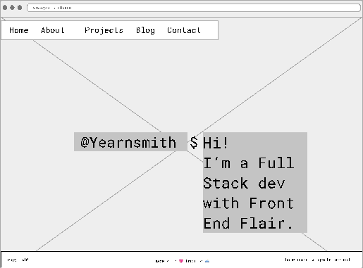
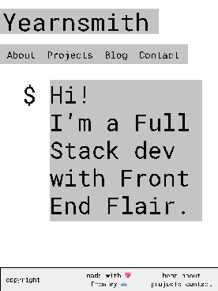
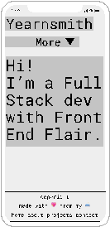
Index.html
Yearnsmith/

Slide 14
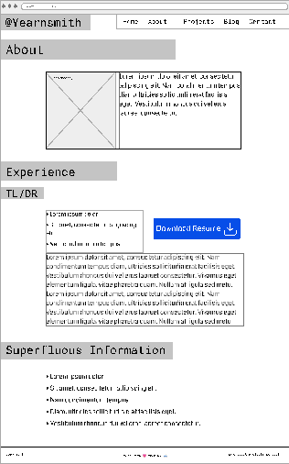
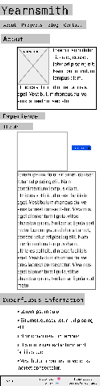

about.html
Yearnsmith/

Slide 15
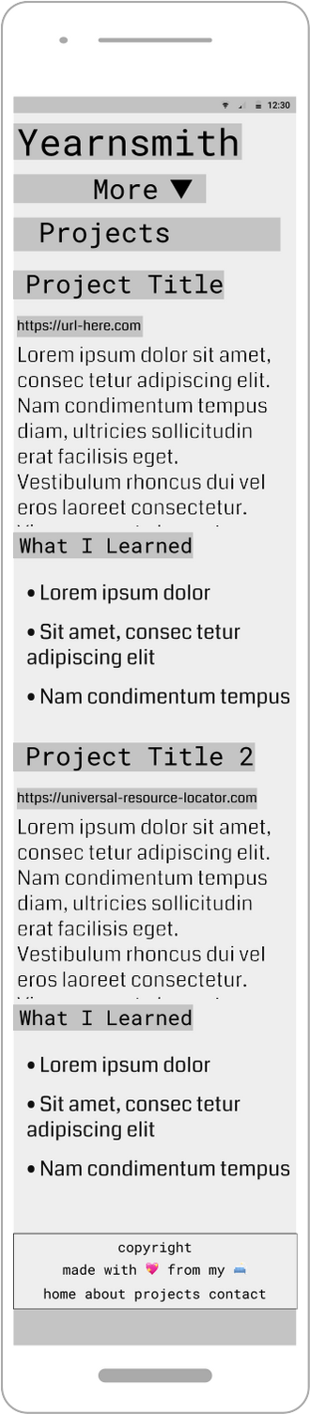
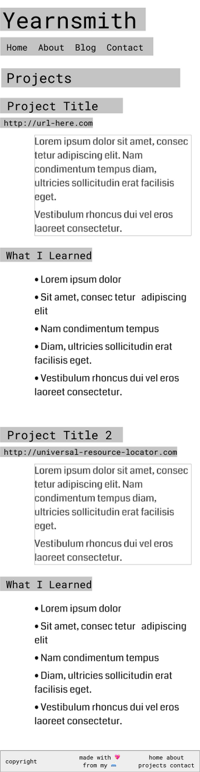
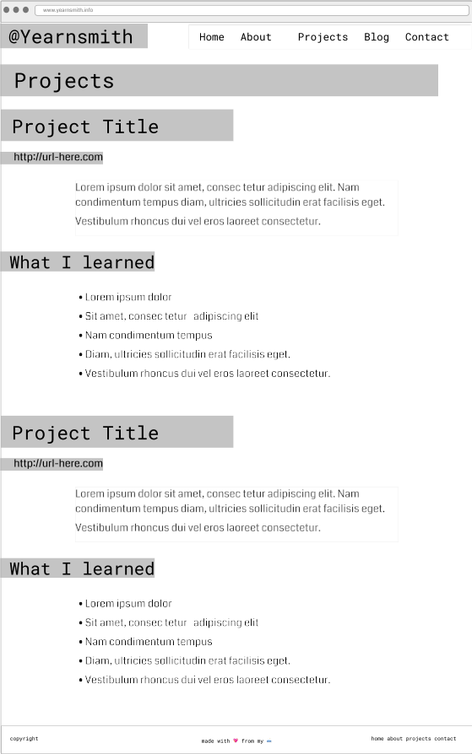
projects.html
Yearnsmith/

Slide 16
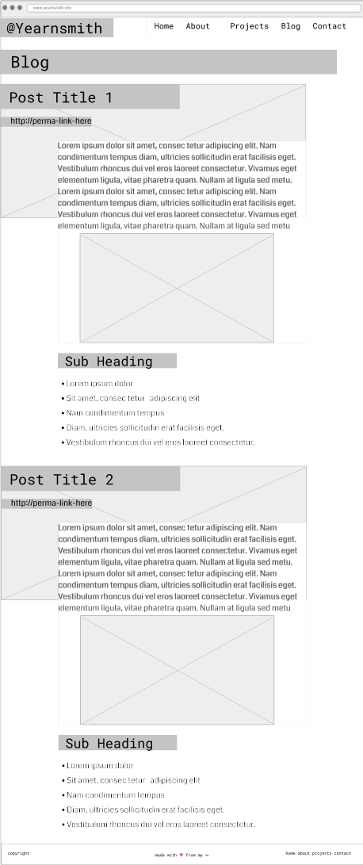
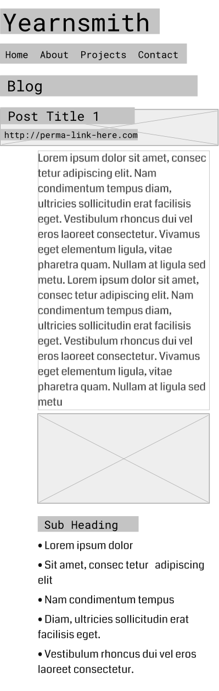
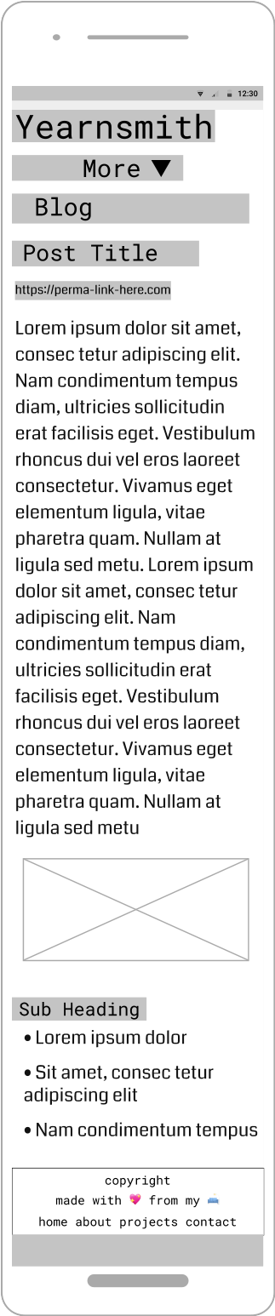
blog.html
Yearnsmith/

Slide 17
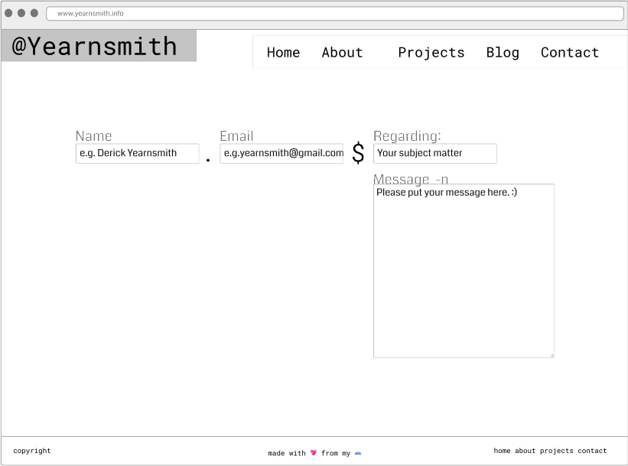
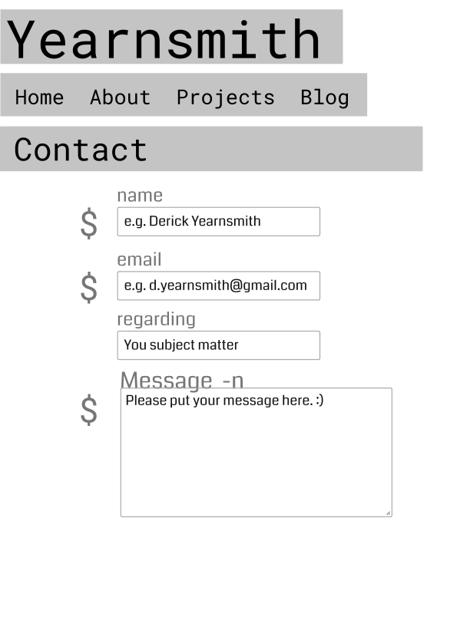
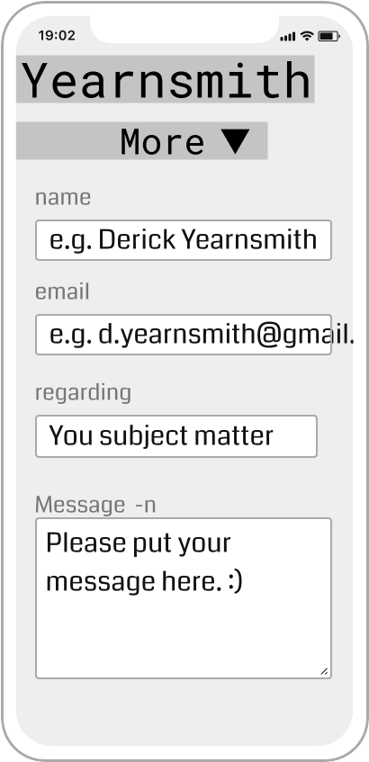
contact.html
Yearnsmith/

Slide 18
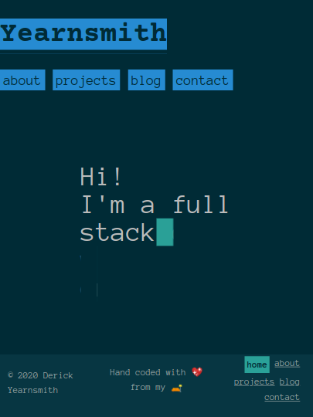
$ components_1
Yearnsmith/~
]
highlighted-text is a Scss @mixin used throughout.
<nav> is a text component
[
An animation… but that’s real, selectable text.
}
Flexbox <footer>.

Slide 19
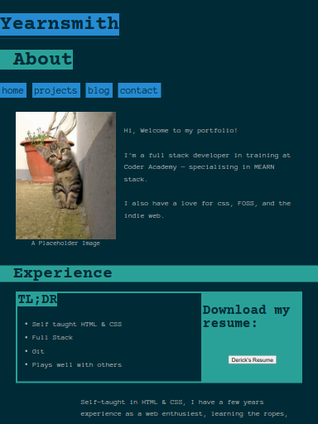
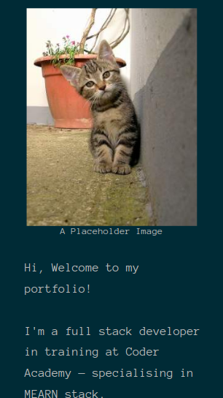
$ components_2
Yearnsmith/~
Wraps to new line and resized image!
]
}
.two-column-flex
( )
Oops, I need to fix that

Slide 20
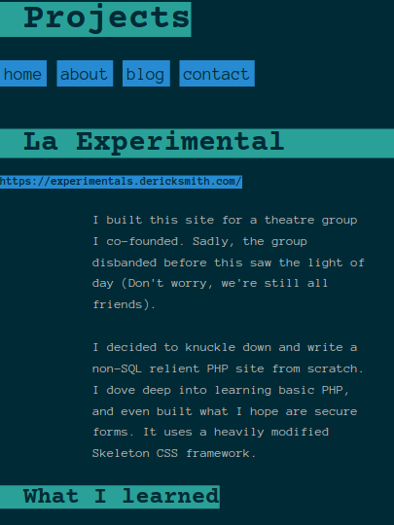
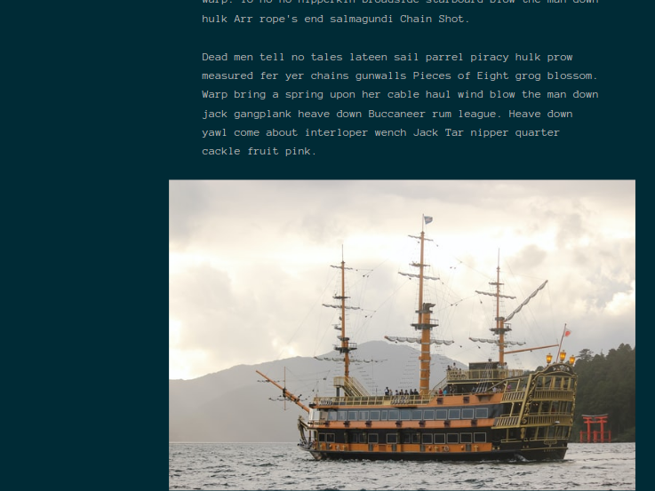
$ components_3
Yearnsmith/~
Blog
These are both articles

Slide 21
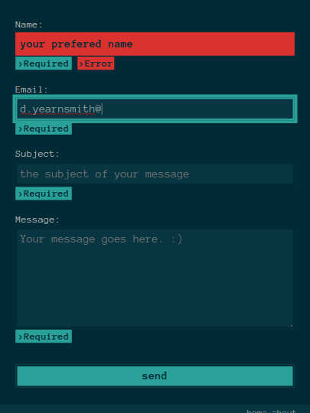


$ components_3
Yearnsmith/~
}
Social Logos

Slide 22
$ Challenges
Yearnsmith/
Delving into fiddly bits (Time!)
Mobile Nav Bar (I always forget that CSS doesn’t select backwards)
Scss partials and folder directories
Lots of other bits

Slide 23
$ ethics
Yearnsmith/
Attribution!
  How much is too much public domain?

Slide 24
$ fun
Yearnsmith/
Figuring out animation
Reading up on web typography
Getting fancy with Scss Partials

Slide 25
$ my-portfolio
Yearnsmith/~
</presentation>

